Slide 1

SNS (DATA SCIENCE ASSIGNMENT)
RAMYA KRISHNAN A
ramyaarul192001@gmail.com

Slide 2
INTRODUCTION
I am Ramya Krishnan, a Data Scientist with a background in Mathematics and certifications in Data Science and Machine Learning. I specialize in predictive modeling, data analysis, and building machine learning models to derive valuable insights. This project focuses on developing a machine learning model to predict mobile phone sales pricesusing data from Flipkart's Mobile Products Dataset. The project aims to enhance the accuracy of price predictions based on various phone attributes, such as brand, processor, RAM, and ratings.

Slide 3
SECTION 1: DATA ANALYSIS AND PREPROCESSING

Slide 4
TASK 1: DATA CLEANING AND TRANSFORMATION
Loading the Dataset: The Flipkart Mobile Data is loaded into a pandas DataFrame for exploration and processing.
Handling Missing Data:
Checked for missing values using df.isnull().sum().
Applied strategies like mean/median imputation for missing numerical data and mode imputation for missing categorical values.
Statistical Summary:
Used df.describe() to get a summary of the dataset’s numerical columns, such as sales price, ratings, and battery capacity.
Encoding Categorical Features:
Applied LabelEncoder to categorical variables (brand, model, base_color, processor) to convert them into numerical form.

Slide 5
TASK 2: EXPLORATORY DATA ANALYSIS (EDA)
Univariate Analysis:
Sales Price Distribution: Plotted the distribution of sales prices using a histogram to understand price ranges and detect outliers.
Brand Count: Visualized the frequency distribution of various brands using a bar plot, showing the popularity of different mobile brands.

Slide 6
TASK 2: EXPLORATORY DATA ANALYSIS (EDA)
Bivariate Analysis:
Sales Price vs. Ratings: Created scatter plots to show the relationship between sales_price and ratings, exploring how customer ratings affect pricing.
RAM vs. Sales Price: Used box plots to examine the correlation between RAM sizes and sales price, analyzing price trends for different memory capacities.

Slide 7
TASK 2: EXPLORATORY DATA ANALYSIS (EDA)
Multivariate Analysis:
Pairplot: Visualized relationships among features such as sales_price, RAM, ROM, battery_capacity, and ratings.
Correlation Matrix: Generated a heatmap to visualize correlations between variables like battery_capacity, ratings, and sales_price, identifying which features strongly influence the target variable.

Slide 8
SECTION 2: MACHINE LEARNING MODEL DEVELOPMENT

Slide 9
TASK 1: MODEL DEVELOPMENT
Data Splitting:
Split the data into training (80%) and testing (20%) sets using train_test_split() from scikit-learn.

Slide 10
TASK 1: MODEL DEVELOPMENT
Modeling Techniques:
Linear Regression: Built a baseline model to predict sales prices and evaluated it using metrics like Mean Squared Error (MSE) and R².
K-Nearest Neighbors (KNN): Implemented KNN to predict prices, tuning the hyperparameter k using the Elbow Method to minimize error.
Decision Tree Regressor: Applied a Decision Tree model and tuned hyperparameters (max_depth, min_samples_split, min_samples_leaf) using GridSearchCV to prevent overfitting.
Random Forest Regressor: Developed a Random Forest model, tuning n_estimators, max_depth, and min_samples_split for optimal results.
XGBoost Regressor: Trained an XGBoost model, optimizing n_estimators, learning_rate, and max_depthusing a grid search for enhanced performance.

Slide 11
TASK 1: MODEL DEVELOPMENT
Evaluation Metrics:
Evaluated the models based on MSE, MAE, R² Score, and RMSE on both the training and test data.

Slide 12
TASK 2: MODEL OPTIMIZATION
Hyperparameter Tuning:
Performed hyperparameter tuning using GridSearchCV for each model to identify the best parameter settings.
Focused on maximizing R² and minimizing error metrics to ensure robust performance on unseen data.

Slide 13
TASK 2: MODEL OPTIMIZATION
Model Comparison:
Compared the performance of the models:
Linear Regression: Showed baseline performance with high bias but was less complex.
KNN: Performed moderately but struggled with higher-dimensional data.
Decision Tree: Worked well but was prone to overfitting.
Random Forest: Demonstrated better performance due to ensemble learning, handling non-linear relationships effectively.
XGBoost: Achieved the best performance with the highest R² score and the lowest MSE, making it the optimal model for predicting sales prices.

Slide 14
SECTION 3: DATA VISUALIZATION AND COMMUNICATION

Slide 15
TASK 1: VISUALIZATION DASHBOARD
Creating the Dashboard:
Tool Used:
Tableau

Slide 16
TASK 1: VISUALIZATION DASHBOARD
Visualizations Included:
Bar Chart for Color-Based Discounts: Shows discount percentages by color category, helping understand which colors are offered with higher discounts.
Donut Chart for Brand-Wise Sales: Visualizes the distribution of sales across different brands, highlighting the most popular brands.
Bar Chart for Model-Wise Sales Price: Displays sales prices for different mobile models, providing insight into pricing strategies for each model.
Tree Map for Model Details: Illustrates overall details of various mobile models, such as sales and ratings, in a hierarchical format.
Side-by-Side Bars for Screen Size vs. RAM and ROM: Compares screen sizes with RAM and ROM for different mobile phones, showing how these features vary together.
Pie Chart for Brand-Wise Ratings: Represents the distribution of ratings across different brands, indicating customer satisfaction levels.

Slide 17
KEY INSIGHTS:
The bar chart for color-based discounts reveals that certain colors receive more substantial discounts, potentially influencing consumer preferences.
The donut chart for brand-wise sales indicates which brands have the highest sales, providing insights into market trends and brand performance.
The bar chart for model-wise sales price highlights pricing strategies, showing which models are priced higher and potentially attracting different customer segments.
The tree map for model details provides a comprehensive view of each model’s performance, including sales and ratings, aiding in the identification of top-performing models.
The side-by-side bars for screen size vs. RAM and ROM offer a comparison of how screen size correlates with other features, revealing trends in feature selection.
The pie chart for brand-wise ratings helps assess customer satisfaction and brand reputation, guiding future product development and marketing strategies.

Slide 18
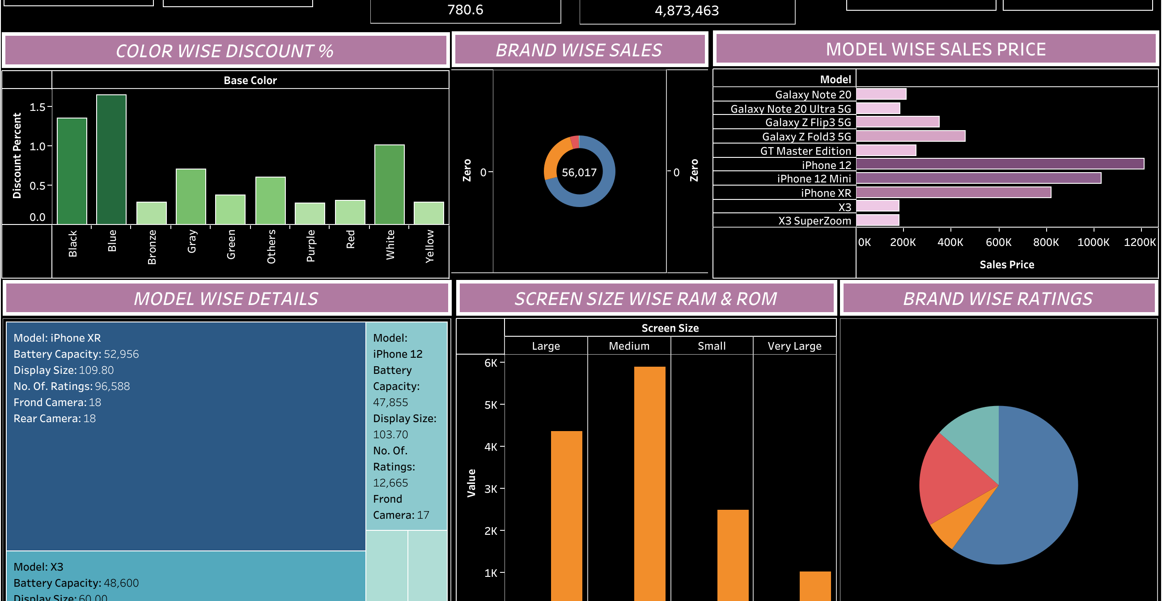

Slide 19
CONCLUSION
The XGBoost Regressor proved to be the most accurate model for predicting mobile phone sales prices, surpassing other models in precision and error metrics. By employing meticulous data preprocessing, feature engineering, and hyperparameter tuning, this project demonstrates how machine learning can offer valuable insights into pricing strategies for retailers.
The Tableau dashboard effectively visualizes key insights, making complex data accessible for stakeholders to make informed decisions regarding sales trends and pricing strategies.
Future enhancements could include adding more features, expanding datasets, and improving model interpretability, further strengthening prediction accuracy and utility. This project showcases the power of advanced machine learning techniques in addressing real-world pricing challenges.

Slide 20


